Slide 1
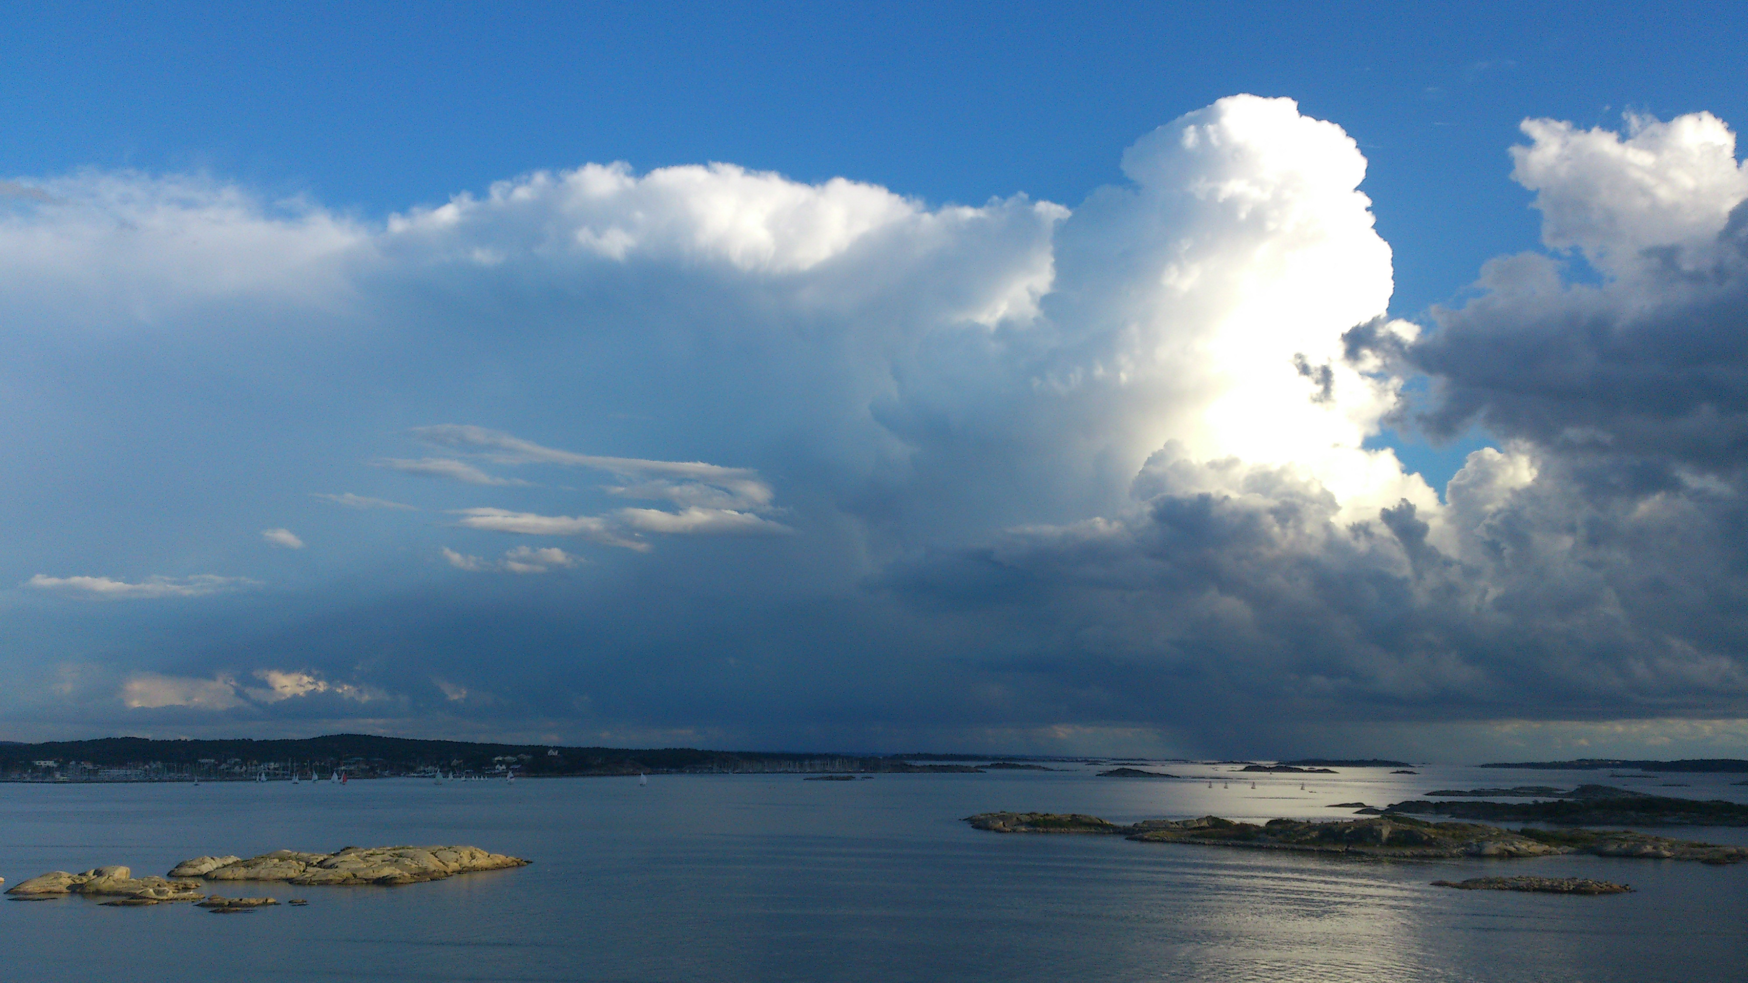
Cloud: parcel? Model?
By Chenxi Qiu & Edward Groot

Slide 2
Content
Introduction & model
What processes does the model include?
Entrainment of ambient air in the parcel model
Environmental air and assumptions
Some experiments & results
No entrainment
Entrainment
Parcel size
Ambient air
Discussion
Conclusion

Slide 3
Mixing
Model: dynamic equations – sources/sinks
W
Mixing
Cloud content
Buoyancy
Mixing
Evaporation
θ
Melting
Condensation
Freezing (&ice deposition)
Mass

Slide 4
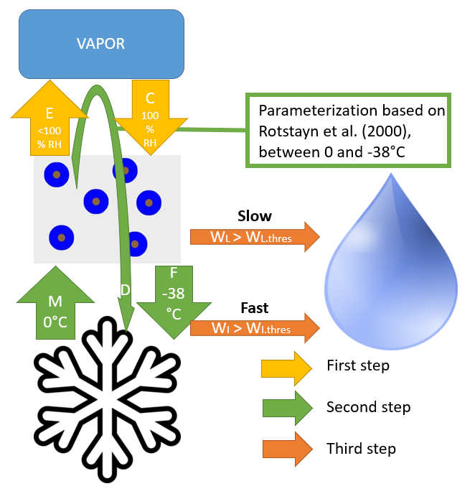
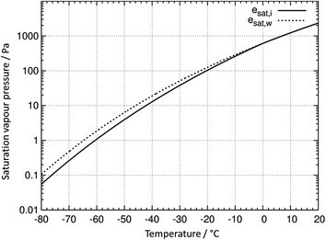
Model: moisture & cloud processes
Leaves parcel
D

Slide 5
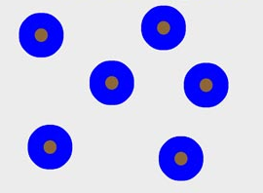


Model: moisture & cloud processes
VAPOR
E
<100% RH
C
100% RH
Parameterization based on Rotstayn et al. (2000), between 0 and -38°C
Slow
Leaves parcel
WL > WL.thres
M
0°C
F
-38 °C
D
Fast
WI > WI.thres
First step
Second step
Third step

Slide 6
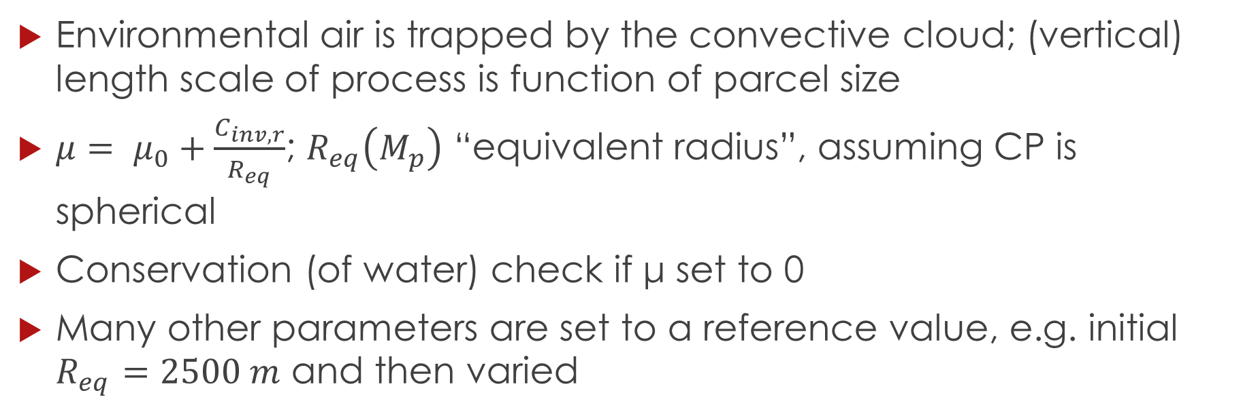
Dynamic entrainment
Environmental air is trapped by the convective cloud; (vertical) length scale of process is function of parcel size
$μ= μ_{0}+\frac{C_{inv,r}}{R_{eq}}$; $R_{eq}\left(M_{p}\right)$ “equivalent radius”, assuming CP is spherical
Conservation (of water) check if μ set to 0
Many other parameters are set to a reference value, e.g. initial $R_{eq}=2500 m$ and then varied

Slide 7
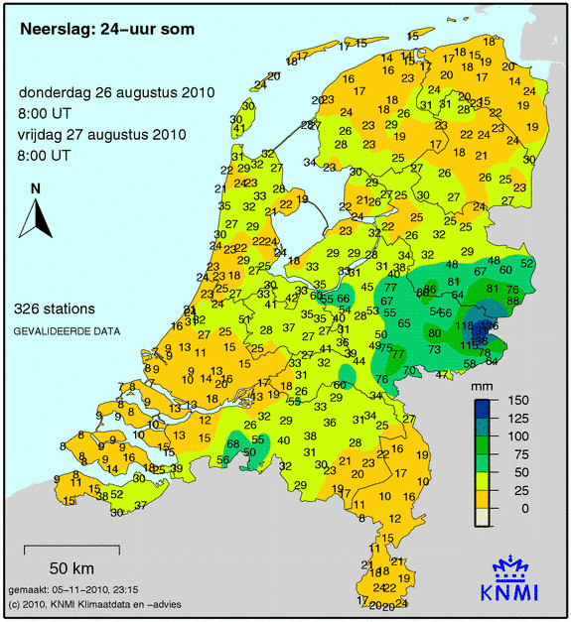
Environmental profile + assumptions
Observations of August 26th 2010 12 UTC/GMT in Essen, Germany
Slightly modified, assuming enriched moisture at ±3 km
Classical “surface based” convection
Linear interpolations between nearest levels
Initial small disturbance T & water vapor
Convective rain event in Gelderland & Overijssel

Slide 8
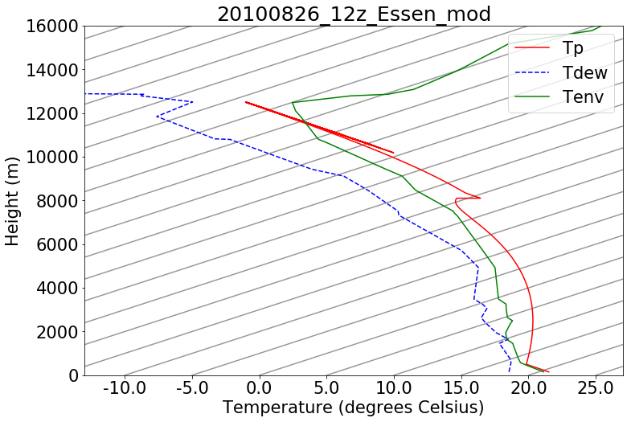
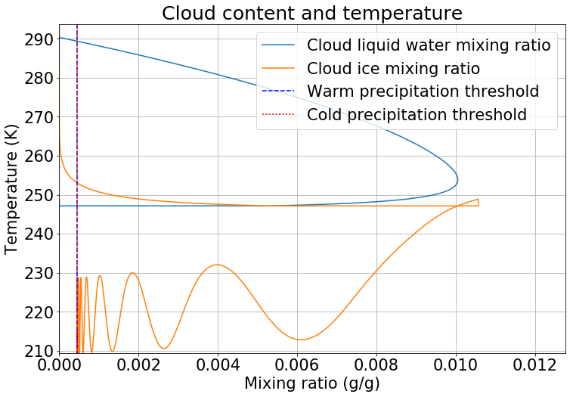
No entrainment
time
isotherms
Z (m)
time
0 °C
Mean precipitation over the final area of the parcel: 4.40 mm

Slide 9
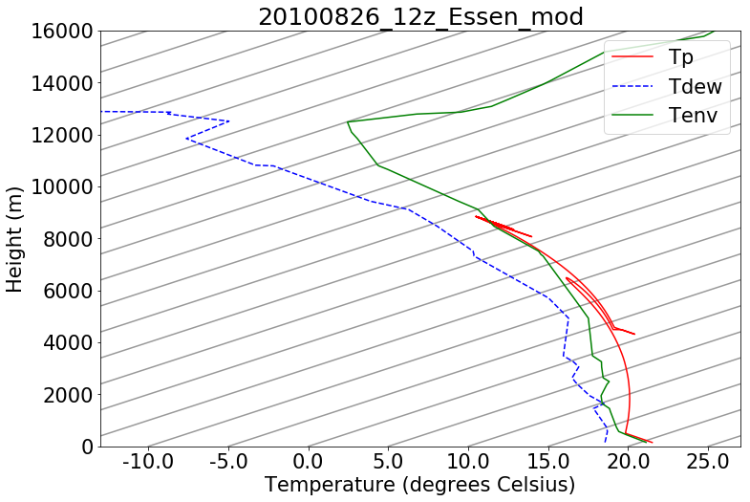
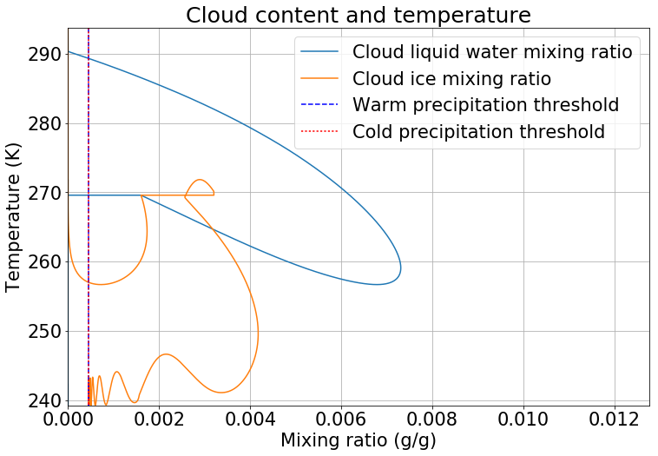

Constant entrainment $μ_{0}=5×{10}^{−5}$
time
isotherms
Z (m)
time
0 °C
Mean precipitation over the final area of the parcel: 3.97 mm

Slide 10
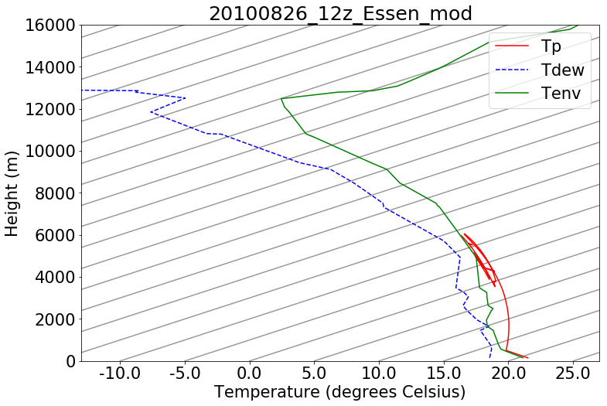
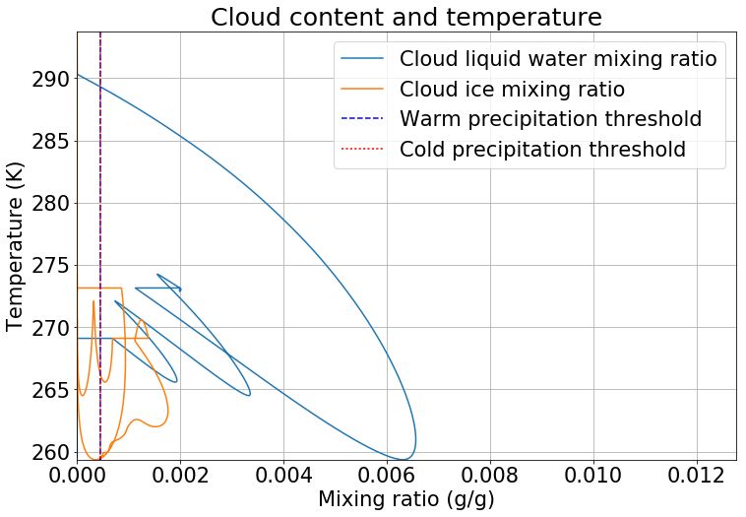


Full entrainment $μ= μ_{0}+\frac{C_{inv,r}}{R_{eq}}$
time
Reference run - $μ_{0}$ = 5e-5 & $C_{inv,r}$ = 0.16: 4.99 mm areal mean precipitation

Slide 11
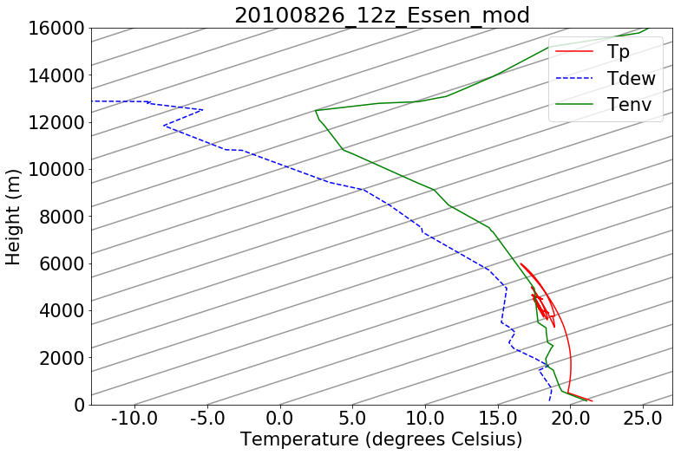
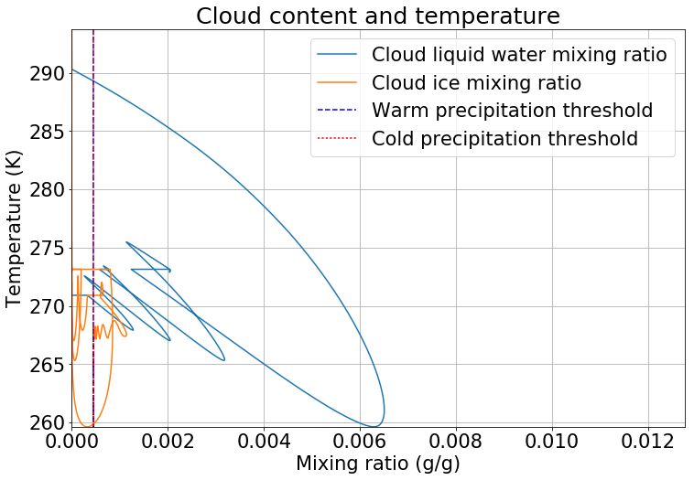
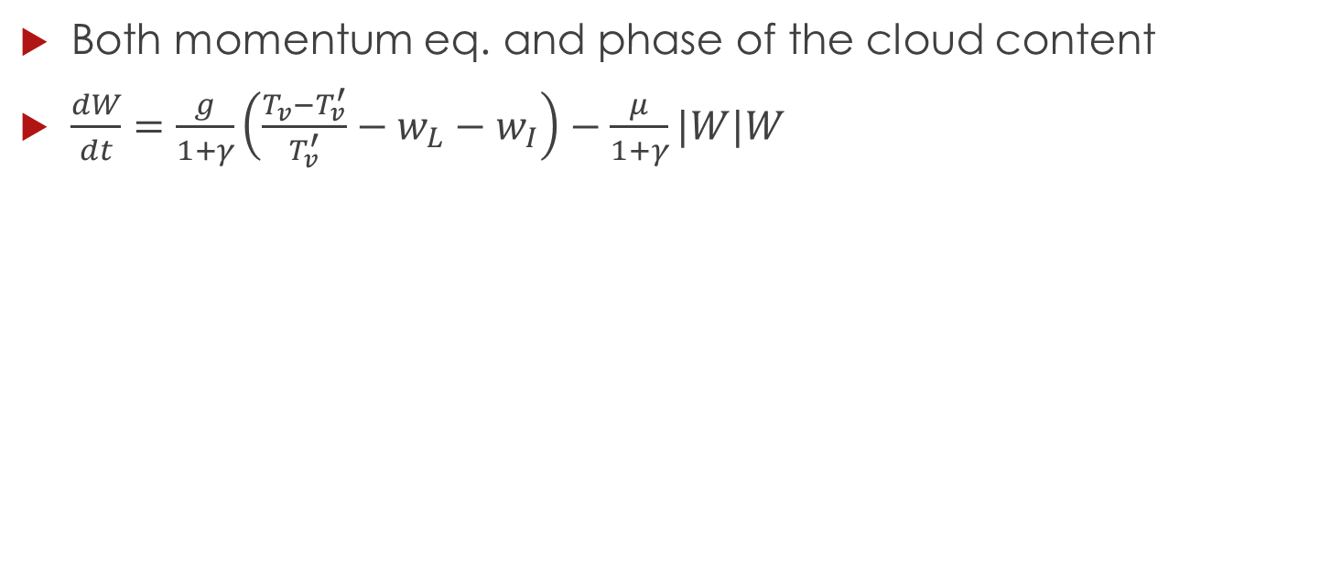
Sensitive
Both momentum eq. and phase of the cloud content
$\frac{dW}{dt}=\frac{g}{1+γ}\left(\frac{T_{v}−T_{v}^{′}}{T_{v}^{′}}−w_{L}−w_{I}\right)−\frac{μ}{1+γ}|W|W$
Tmelt

Slide 12
Change of μ0 to 2e-5
Mean areal precipitation of 4.29 mm
We did more experiments

Slide 13
Change initial Req
Reference value: 2500 m; reasonable values 300-5000 m
No cloud at 10 m and negligible at 100 m
At 500 m: cloud with negligble ice content, very little precipitation (<0.1 mm)
But this cloud has relevance for environmental moisture at z = 2.5-3 km
With 2500 m: result already shown as “full entrainment”

Slide 14

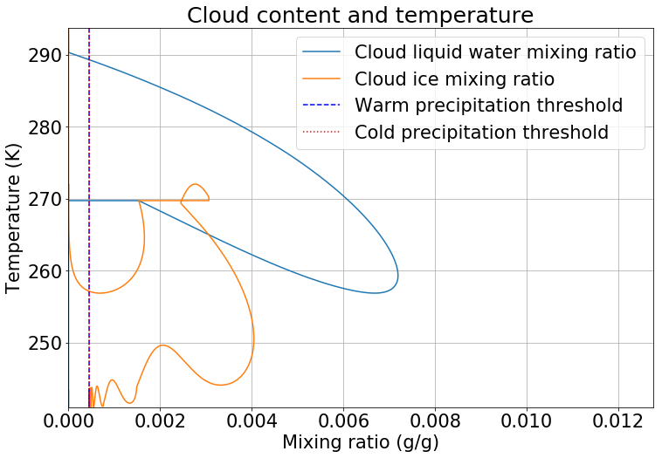
Change initial Req: 5000 m
Mean areal precipitation is 9.22 mm.

Slide 15
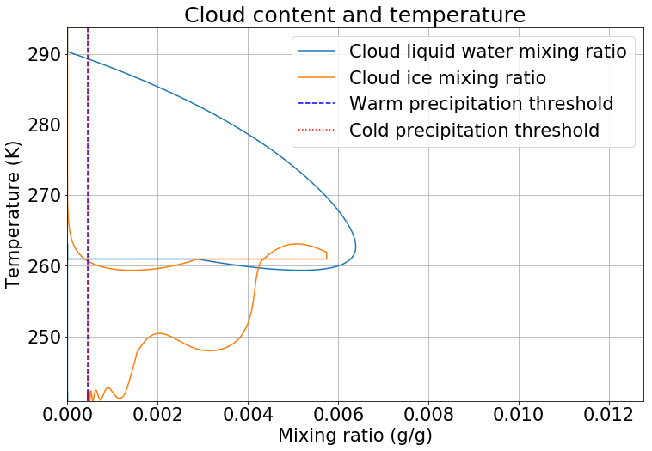
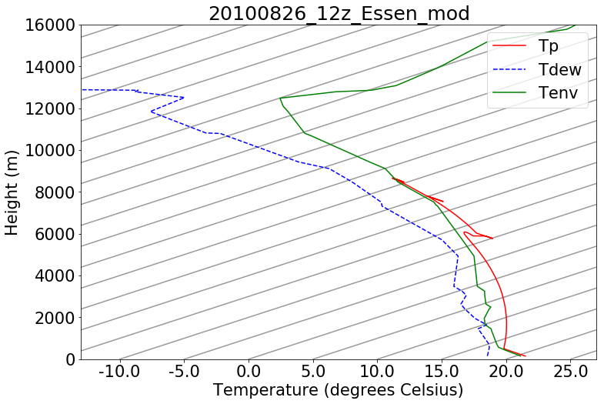
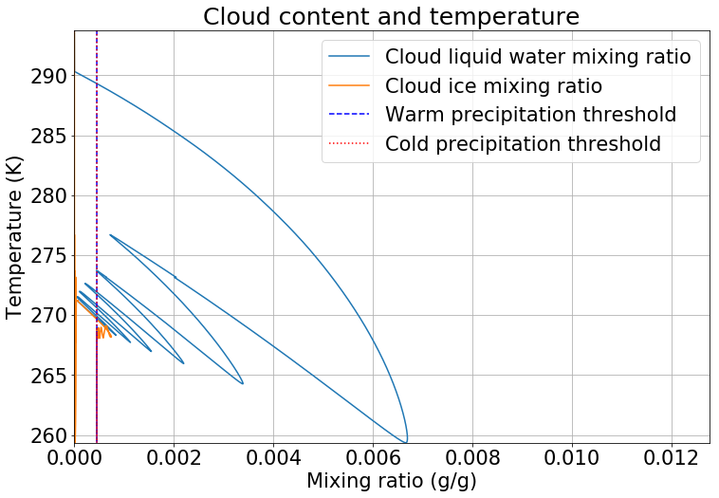

Sensitivity cloud water to ice conversion
If we set the ice initiation lower, little ice is initiated and less (mostly “warm”) precipitation can be produced
At superfast rate: 100% ice at ±260 K
Heat of fusion may be important buoyancy push, although small (< 2K)
“Cconv”=25 “Cconv”=1

Slide 16
Sensitivity upper air moisture
Reduction of moisture above z = 2 km
Reduction | Mean precipitation (mm) | Cloud equilibrium temperature (K)
0% | 4.99 | 260
2% | 4.02 | 264
4% | 2.50 | 267
25% | 0.34 | 277

Slide 17
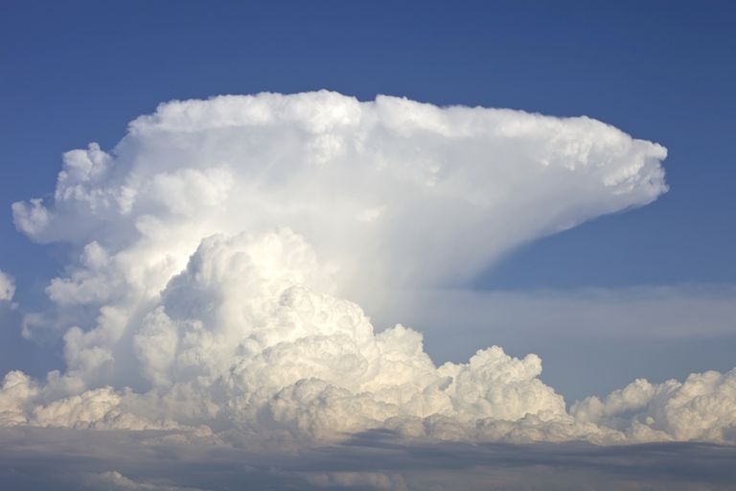
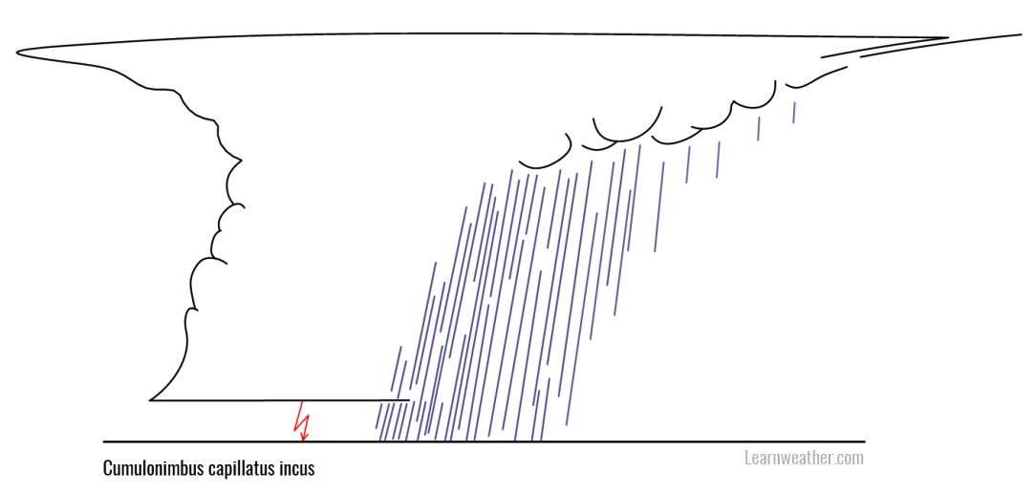
Discussion
Horizontal dynamics excluded in parcel model, but essential as “sorting mechanism”

Slide 18
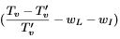
Discussion
No oscillatory behavior in reality, (either dissipation or persistance)
In this model, condensed water or ice gets either inside or outside parcel
Interaction parcel & cloud content
Limitation of parcel model
In general the parameterizations (foremost conversion to ice) are hugely simplified
No sublimation/riming (all via liquid water)

Slide 19
Conclusions
The parcel model allows us to illustrate some of the senstivity of convective clouds to entrainment intensity, parcel size, cloud microphysics, initial parcel and environmental conditions
However, there are important limitations:
no horizontal wind field
Feedbacks, such as release of heat of fusion may be important for the evolution of the cloud and result (e.g. precipitation)
In reality, many different convective clouds may co-exist and interact

Slide 20
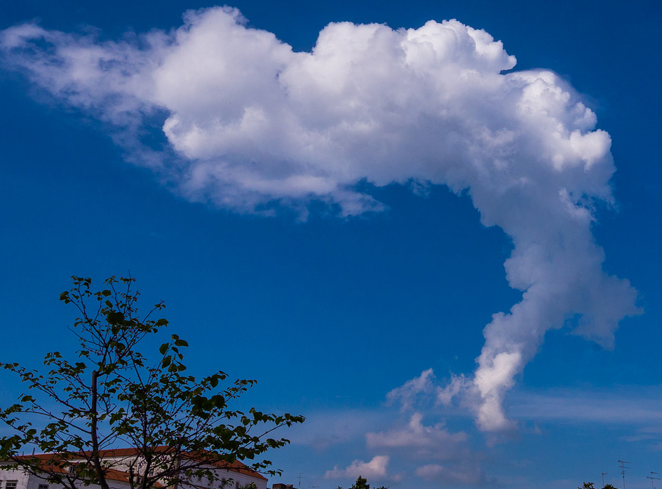
Thank you for your attention

